Slide 1
JavaScript Operators
Mirzoulugbek Yusupov

Slide 2
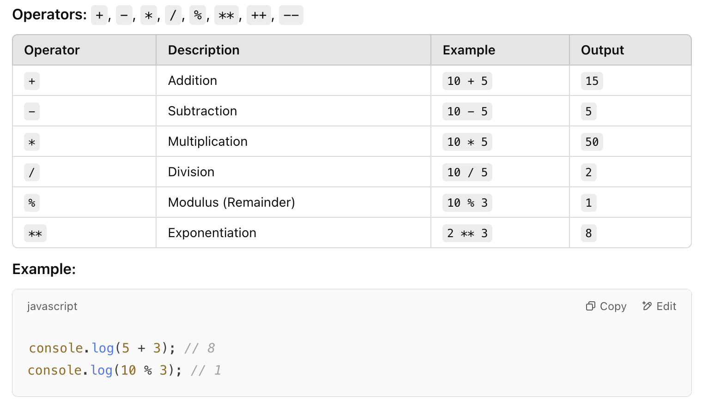
Arithmetic Operators

Slide 3
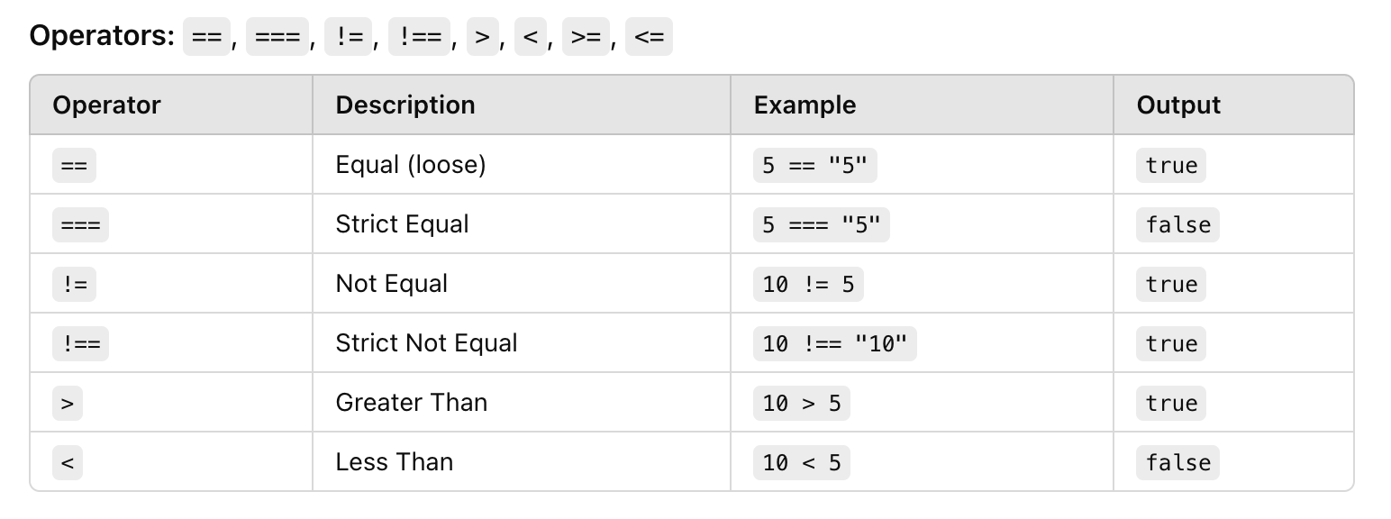
Comparison Operators

Slide 4
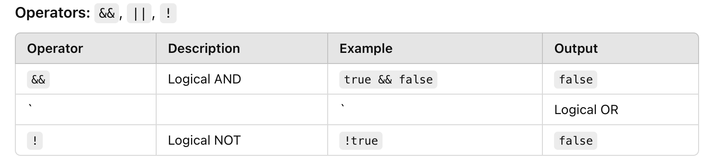
Logical Operators

Slide 5
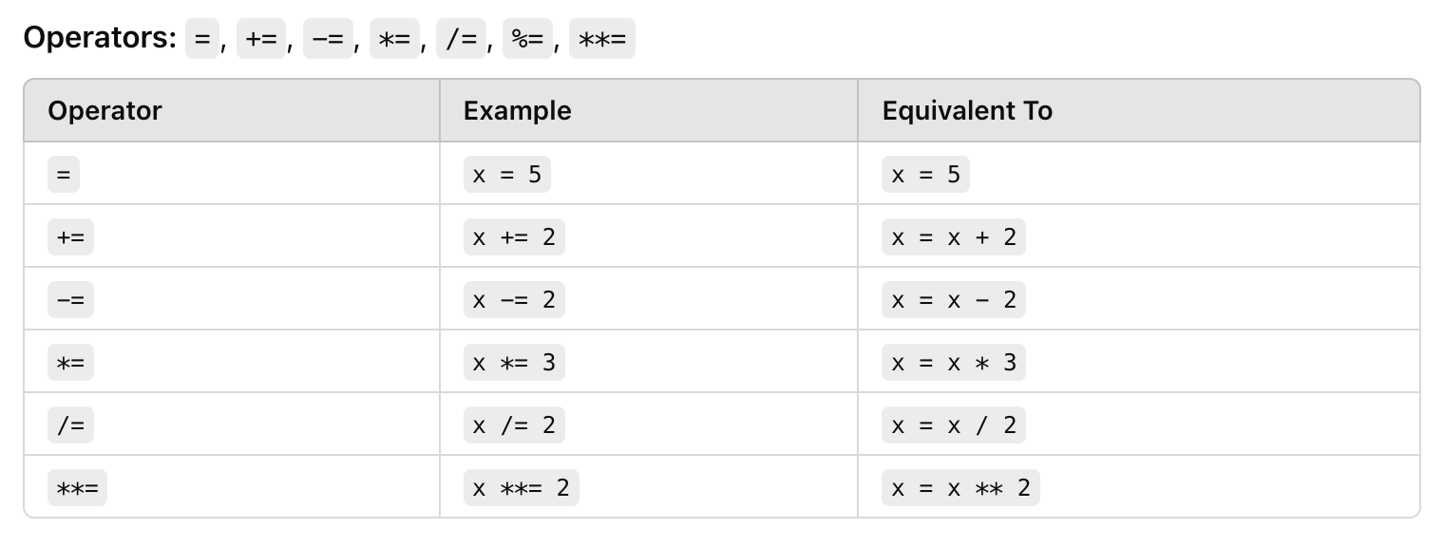
Assignment Operators

Slide 6
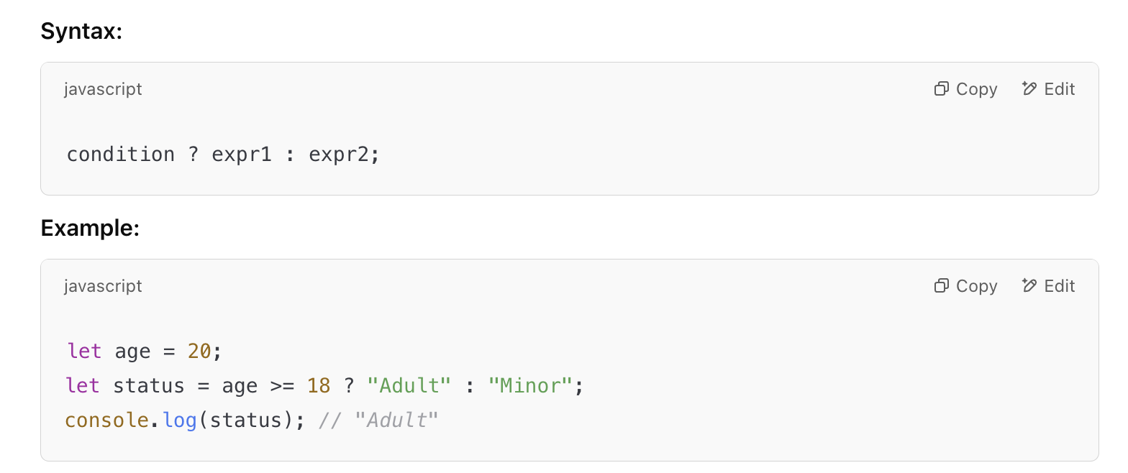
Ternary Operator (? :)

Slide 7
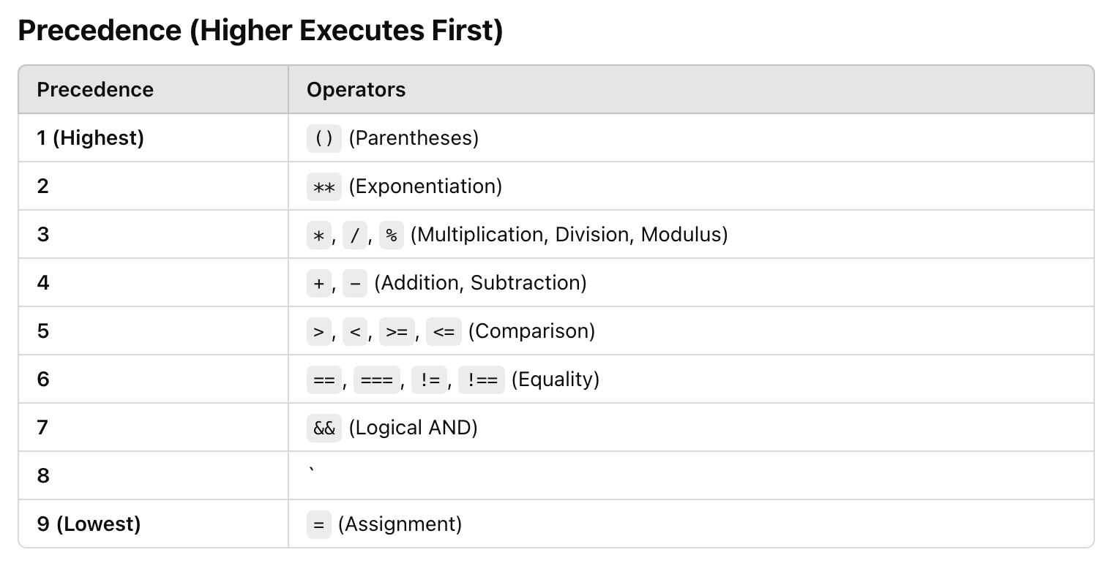
Precedence & Associativity

Slide 8
Practice
Challenge – 1
The program should count how many even and odd numbers exist between 1 and a given number.
Print the count of even and odd numbers separately.
Use the modulus (%) operator to check if a number is even or odd.
Challenge – 2
Take a number as input and reverse it using only operators, loops, and if conditions.
Example: 1234 → 4321
Use the modulus (%) operator to extract the last digit.
Use division (/) to remove the last digit.
Challenge – 3
Take a number as input and find the largest digit using only operators, loops, and if conditions.
Extract digits using the modulus (%) operator.
Compare each digit with the current largest digit using if conditions.
Remove the last digit using division (/) inside a loop.

Slide 9
Practice
Challenge – 4
Take a number as input and find the sum of its digits using only operators, loops, and if conditions.
Use the modulus (%) operator to extract the last digit.
Use addition (+) to sum up the digits.
Remove the last digit using division (/) inside a loop.
Challenge – 5
Take a number as input and count how many digits it has using only operators, loops, and if conditions.
Use division (/) inside a loop to remove digits one by one.
Use a counter variable to keep track of the number of digits.

